Slide 1
Amazon Music
Design Sprint
Product Manager: Bipin Kumar Sultania
© 2019 Udacity. All rights reserved.

Slide 2
Set the stage
Set the stage for the Design Sprint by framing the problem
© 2019 Udacity. All rights reserved.
Notes:
[ALL PARTICIPATION]

Slide 3

Initial PRD
Link your PRD

Slide 4
Understand
Create a shared understanding of the space, problem, and goals
© 2019 Udacity. All rights reserved.
Notes:
[ALL PARTICIPATION]

Slide 5
How Might We
How might we add karaoke feature?
How might we incentivize user on uploading own music?
How might we allow user to rate music?
How might we ensure users to stream music even in low bandwith?
How might we sync the lyrics highlight with the song?
How might we check for duplicate song?
How might we make content downloads quick?
How might we let user to cut clip of music?
How might we logout from all connected devices in one go?
How might we make sure the user don’t hear the same music while using shuffle?
How might we let user to share music in all the social media?
How might we share the entire playlist to other user?
How might we keep all the categories of music?
How might we provide UI themes?
How might we build Alexa skills related to music?
How might we provide visuals based on the music type?
How might we provide in built editing tool?
How might we let user delete all the downloaded song in single click?
How might we attract independent music composers ?
How might we find corrupted song?
How might we ensure security to user personal music upload?
How might we create multi user profile?
How might we implement live streaming?

Slide 6
Other stickies 1
How might we categorize videos by genre?
How might we make it easy to upload music and videos?
How might we check for music copyright violations?
How might we check for image copyright violations?
How might we allow users to promote their content on social media?
How might we ensure that content is original?
How might we reward publishers for better content?
How might we share local concert information?
How might we provide video editing tools?
How might we provide music editing tools?
How might we allow users to rate music?
How might we categorize music into genres?
How might we make content downloads easy and quick?
How might we make artist landing pages interesting?
How might we assess content quality?
How might we allow users to update content?
Allow users to rate videos?
How might we ensure that users are not exposed to offensive material?
How might we help users step out of their comfort zone?
How might we make content uploads easy and quick?

Slide 7
Other stickies 2
How might we create a way of discovering these new products?
How might we narrow the markets within each choice to the most likely to succeed?
How might we measure impact on customers and creators?
How might we determine which market is best for Amazon?
How might we create a rapid prototyping model for testing in both markets?
How might we share music that a user is likely to enjoy?
How might we allow users to discover music they might like?
How might we determine what is a more lucrative direction?
How might we adjust our platform to support the new verticals?
How might we differentiate our distribution to competitors?
How might we encourage creators to come to our platform?
How might we convert book authors to other media?
How might we test which field would be better to invest in between music or video?
How might we make our content available to people with limited vision?
How might we find fake ratings?
How might we facilitate easy social sharing?
How might we ensure that the content is original?
How might we add parental ratings for content?
How might we make the music sound better?
How might we create a new experience for customers/creators

Slide 8
Other stickies 3
How might we allow artists to collaboratively create content?
How might we allow people to watch/listen to content relevant to them?
How might we allow users to create and upload their own videos online?
How might we incentivize artists to share content on Amazon’s platform?

Slide 9
User Interface and Experience
How might we help users step out of their comfort zone?
How might we let user to cut clip of music?
How might we provide in built editing tool?
How might we make it easy to upload music and videos?
How might we provide video editing tools?
How might we create a new experience for customers/creators
How might we provide UI themes?
How might we provide visuals based on the music type?
How might we provide music editing tools?
Editing
UI/Theme
How might we determine which market is best for Amazon?
How might we categorize videos by genre?
How might we create a rapid prototyping model for testing in both markets?
How might we narrow the markets within each choice to the most likely to succeed?
How might we make sure the user don’t hear the same music while using shuffle?
How might we categorize music into genres?
How might we let user delete all the downloaded song in single click?
How might we keep all the categories of music?
How might we determine what is a more lucrative direction?
How might we test which field would be better to invest in between music or video?
Playlist
Market
Put clusters of stickies here that have a related theme
Describe the theme in the title
Copy this slide as needed for each additional theme

Slide 10
Content
How might we incentivize user on uploading own music?
How might we incentivize artists to share content on Amazon’s platform?
How might we make artist landing pages interesting?
How might we share the entire playlist to other user?
How might we attract independent music composers ?
How might we allow users to update content?
How might we convert book authors to other media?
How might we create a way of discovering these new products?
How might we reward publishers for better content?
How might we share music that a user is likely to enjoy?
How might we facilitate easy social sharing?
How might we allow artists to collaboratively create content?
How might we implement live streaming?
How might we let user to share music in all the social media?
How might we share local concert information?
How might we allow users to create and upload their own videos online?
How might we allow users to promote their content on social media?
How might we encourage creators to come to our platform?
How might we ensure security to user personal music upload?
Sharing content
New content

Slide 11
Native Experience
How might we ensure users to stream music even in low bandwith?
How might we make content downloads quick?
How might we make the music sound better?
How might we measure impact on customers and creators?
How might we make our content available to people with limited vision?
How might we adjust our platform to support the new verticals?
How might we differentiate our distribution to competitors?
How might we make content downloads easy and quick?
How might we make content uploads easy and quick?
How might we assess content quality?
How might we allow users to discover music they might like?
How might we allow people to watch/listen to content relevant to them?
Speed
Quality
How might we add parental ratings for content?
Recommendation
How might we find corrupted song?
How might we logout from all connected devices in one go?
How might we check for duplicate song?
How might we ensure that users are not exposed to offensive material?
How might we ensure that the content is original?
How might we check for image copyright violations?
How might we find fake ratings?
How might we ensure that content is original?
How might we allow users to rate music?
How might we allow user to rate music?
How might we check for music copyright violations?
Allow users to rate videos?
Rating
Security and License

Slide 12
Others
How might we sync the lyrics highlight with the song?
How might we add karaoke feature?
How might we build Alexa skills related to music?

Slide 13
Sprint Focus
Focus | Native Experience
Slide # | List slide # 11
I selected this theme because | Speed, Quality, recommendation are some of the very important factor to retain any user. If our app very slow then user won’t use it for too long. Also the quality of music with good recommendation is very important to keep up with the competition. Once this is done, would work on user experience and new content.

Slide 14
Define
With an understanding of the problem space, create focus and align on specific outcomes for the Design Sprint
© 2019 Udacity. All rights reserved.
Notes:
[ALL PARTICIPATION]

Slide 15
Success Metrics
 | Goals | Signals | Metrics
Happiness | Users find all the song and find the app fun, and easy to use | • Responding to surveys • Leaving 5-star ratings for app • Leaving user feedback | • Net Promoter Score • Customer satisfaction rating • Number of 5-star reviews
Engagement | Users enjoy app content and keep engaging with it | • Spending more time in the app | • Average session length • Average session frequency • Number of conversions (consuming content, uploading files, subscription, etc.)
Adoption | New users see the value in the product and share with friends | • Downloading, launching app • Signing up for an account • Refer a friend • Share on social media | • Download rate • Registration rate • Refer singup rate • Reference in social media
Retention | Users keep subscribing | • Staying active in the app • Renewing a subscription | • Churn rate • Subscription renewal rate
Task Success | Users | • Finding and viewing content quickly •Adding new content | • Search exit rate • Crash rate

Slide 16
Now Streaming: Amazon Music Unlimited by TimesNow
Seattle 16th May, 2020 - Amazon is going to introduced Amazon Music, an on-demand music service that redefines music streaming by putting a catalog of tens of millions of songs and thousands of hand-curated playlists and personalized stations not just at the tips of your fingers, but also on the tip of your tongue. Amazon Music will rediscover the new music or use will be able to listen to favorites easier and with lot more fun than ever with a newly designed Amazon Music app as well as with innovative new Alexa voice controls.
Amazon Music brings real value to the millions of people who are already Prime members, with a choice of subscribing for only $8.99 a month or even $79 per year. Plus, customers are going to love Amazon Music’s all-new app for iOS, Android and desktop,” said Jeff Bezos, Amazon Founder and CEO. “And if you want a sense of the future of voice-controlled music, go ahead and ask Alexa for a free Music Unlimited trial, and play around on your Echo. If you don’t know the name of a song but know a few lyrics, if you want to hear songs from a specific decade, or even if you’re looking for music to match your mood, just ask.

Slide 17
Sketch
Generate tons of ideas, then narrow them down to two in depth solution sketches
© 2019 Udacity. All rights reserved.
Notes:
[ALL PARTICIPATION]

Slide 18
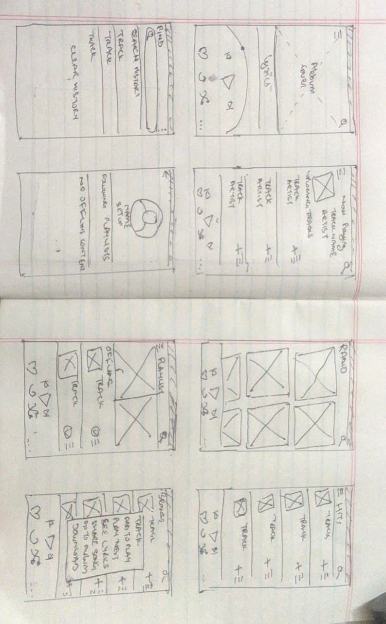
8 Sketches
Photo of your 8 sketches here

Slide 19
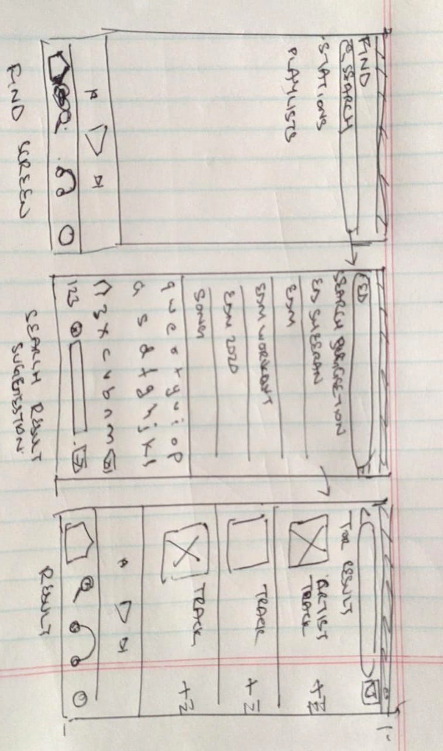
Solution Sketch 1 – Search Screen
Upload a photo of your sketch on this slide

Slide 20
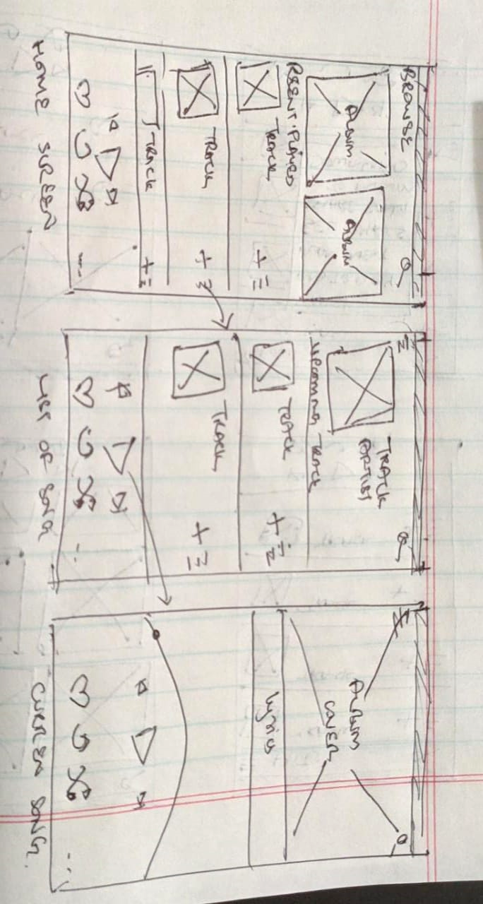
Solution Sketch 2 – Play from List
Upload a photo of your sketch on this slide

Slide 21
Decide
Pick the final concept that you develop into a prototype
© 2019 Udacity. All rights reserved.
Notes:
[ALL PARTICIPATION]

Slide 22
Decision
Decision | Solution Sketch 1 – Search Screen
Rationale | Search is a must to let users find songs by artist and title. It is one of the most important and used functionality for any streaming music app. A search is a to guide for the user. We have to use this space to offer the user some suggestions or curated content such as “Popular Searches”, “Favorites”, “Closest”, or “Top Rated”.

Slide 23
Prototype
Turn your concept into a realistic, interactive prototype that you will use to validate your assumptions and ideas
© 2019 Udacity. All rights reserved.
Notes:
[ALL PARTICIPATION]

Slide 24

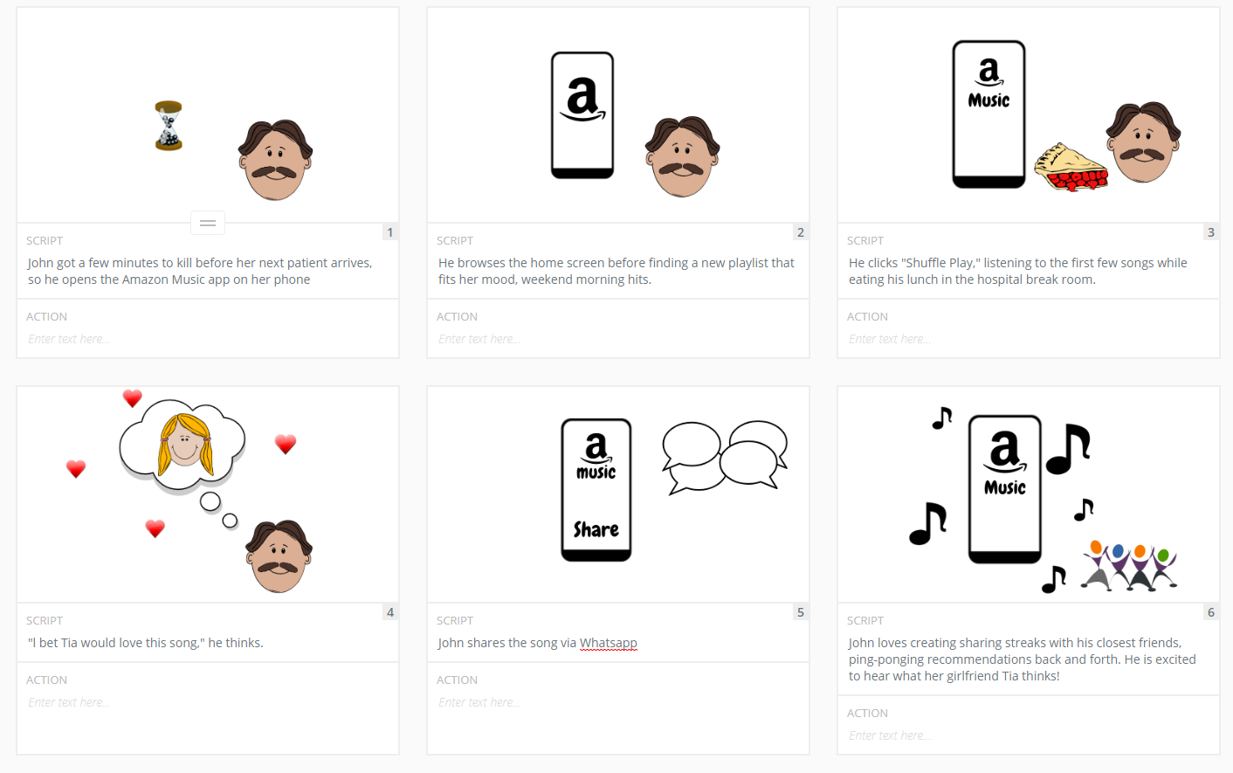
Storyboard
Link your plot
Upload your storyboard on this slide

Slide 25

Prototype
Description High level overview of the prototype What does it do? | An app that can play millions of songs. Listen to the songs you love and find music from all over the world. Play music on your mobile. Listen to music, albums and playlists wherever you are.
Assumptions Any assumptions within the prototype | Users always need to create an account
Tasks What are the tasks that a user can complete in the prototype? | Discover new music and albums Search for song, or artist Make your own playlist See the lyrics of the current song
Link your prototype

Slide 26
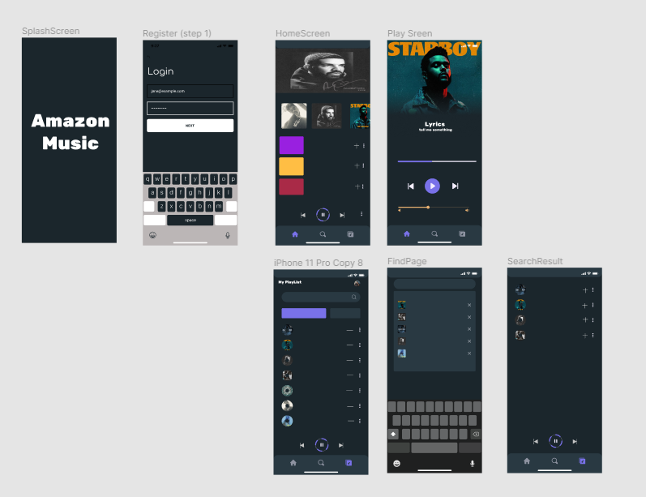
Prototype Screenshot

Slide 27
Validate
Users will go through your prototype and provide feedback on your concept. This is also an opportunity to have an engineering feasibility discussion
© 2019 Udacity. All rights reserved.
Notes:
[ALL PARTICIPATION]

Slide 28
Plan and recruit for research
Link your research plan

Slide 29

User Testing
Link your
notes
Link your audio recording
Key Findings from Participant 1
What worked well | The dark mode with the ability to search any song.
Where participants got stuck | None.
Other observations | For the not long the content the subscription price is also very important. The major concern is the availability of the song offline or not as user has connectivity issues.

Slide 30
User Testing
Link your
notes
Link your audio recording
Key Findings from Participant 2
What worked well | Overall UI is clean
Where participants got stuck | In creating playlist.
Other observations | Content is vey important for working class, want advance features of playlist management and themes for UI.

Slide 31
Improvements
Improvement #1 | Voice Search
Rationale | With the increasing dependency on the voice assistant, many user don’t want to type. This is nice to have feature considering we are already planning to build alexa skills we can always go ahead and add voice search too.
Improvement #2 | Playlist management
Rationale | Need to create and manage multiple playlist. User want the capability to arrange song based on the type and mood. Just single playlist is not sufficient.

Slide 32
Handoff
© 2019 Udacity. All rights reserved.
Notes:
[ALL PARTICIPATION]

Slide 33
Updated PRD
Link your PRD
Bipin Kumar Sultania

